Slide 1
CSCI 2100B: Data Structures Project 2-3-4 Tree
Lai Tai Yi
Lam Kam Ho
Lui Lok Hang Kenneth

Slide 2
What is 2-3-4 Tree
Basic Properties:
Multi-way Tree
Unique data
Each node contains
Up to 3 Data items (D)
2 to 4 Children (L)
L=N+1

Slide 3
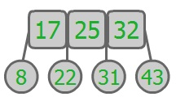
What is 2-3-4 Tree
Suppose each node is an Array item[] with length 3
Data in item[0] < Data in item[1] < Data in item[2]
Suppose the order of children is from left to right.
1st child < item[0].
item[0] < 2nd child < item[1].
item[1] < 3rd child < item[2].
item[2] < 4th child
item[] : 0 1 2
children: 1 2 3 4

Slide 4
What is 2-3-4 Tree
Special Properties:
Node: ≥ 2 Children; Leaf : = 0 Children
Node Splitting
keeps the tree balanced during insertion.
Self-Balanced
ALL leaves with same level
value of item[1] ≈ median of its subtree.
It is commonly used to implement dictionaries.
Why? (We ‘ll come back to these issues in the Insertion part.)

Slide 5
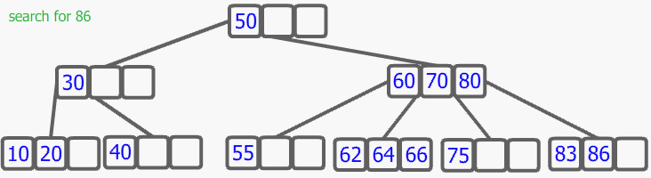
Search
≈ search() in BST
start from root
unless the key is found, select the link that leads to the subtree with the appropriate range of values.

Slide 6
Insertion
Rule: Inserted data items are always be leaves
Case1: no full node is met
When the right leaf node is reached, the new data item is inserted into it.
moving one or two other items in a node may occur for keeping correct order after the new item is inserted.
example with diagram is in next page

Slide 7
Insertion
Case 2: Non-root full node is met
‘Node Split’ is needed
Only full Nodes are split.(top-down 2-3-4 tree)
An empty node(N) is created on the right of the “full node”
item[2]: to N.
Item[1]: to the parent of the “full node”.
Item[0]: unchanged
The connection are cut rightmost two children of “full node” are cut and connected to the new node.
When the right leaf node is reached, the new data item is inserted into it.

Slide 8
Insertion
Case 3: root is full
‘Node Split’ is needed
A new root(Rn) is created and becomes the parent of the old root.
An empty node(N) is created and becomes a sibling of the old root.
Let data items in the “old root” be item[0],[1],[2]
item[2]: to N
Item[1]: to Rn
Item[0]: unchanged
The connection of rightmost two children of “full node” are cut and connected to the new root.
When the right leaf node is reached, the new data item is inserted into it.
Example with diagram is illustrated in next page

Slide 9

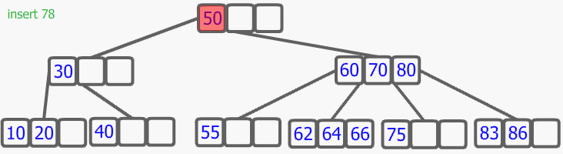
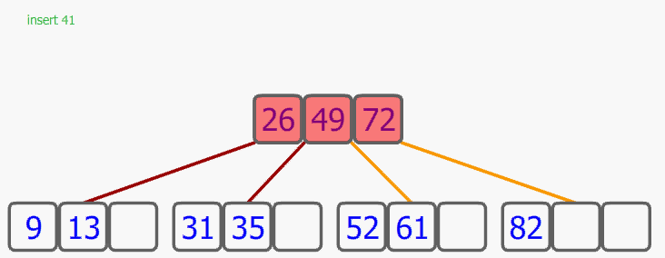
Insertion
Case 1:
Case 2:
Case 3:

Slide 10
Discussion: Insertion & Node Split
A node has at least has 2 Children, unless it is a leaf.
Explanation:
If insertion point in the Root/Node is not full, the new item must be inserted into that node.
When full node(N) is met, “Node Split” occurs. N[2] is moved to the node in upper level (Np) and Np must connected to the two spitted nodes(part) from the old node.

Slide 11
Discussion: Insertion & Node Split
2. 2-3-4 Tree is a self-balanced Tree.
Explanation:
It doesn’t like BST. When item is inserted, it creates a new level for insertion. This may leads to accumulation of data in one subtree and the height of leaves are different.
The key concept of 2-3-4 tree insertion is “Node Spilt”.
It moves the middle item of a full node to its parent/new node created to make space for new items.
It is a concept that push a new subtree of the full node‘s parent out which is same level with the full node.
The tree grow “horizontally”

Slide 12
Deletion
Rule:
The item to be deleted must be a leaf node
If not, it is swapped with a preceding element in in-order traversal (which must be in a bottom node) and that element removed instead.
Transforming a 4-link-node(3 items) into a 3-link-node/ a 3-link-node(2 items) into a 2-link-node(1 items)
Deletion of 2-link-node needs special handling

Slide 13
Deletion
Deleting item in 1-item node cause a node with no item( Called: Underflow).
Transfer is needed.
An item in parent node is moved into the node where the item is being removed.
The new free space in the parent node is replaced with an item from a sibling node.
When the siblings are also 1-item node
Underflow still occurs
Pulling item from the parent node
Two sibling nodes are fused together
Move the item in the larger sibling node to the parent node
Delete the item
When the parent are also 1-item node
Using “Transfer” Again(borrow item from its parent)
As deletions and replacements are being made, This may cause different parent node to sustain underflow which is called Underflow Cascading.

Slide 14
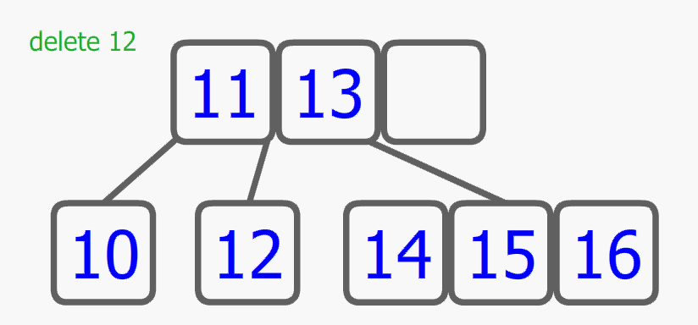
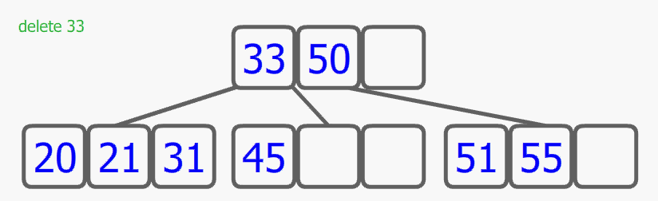
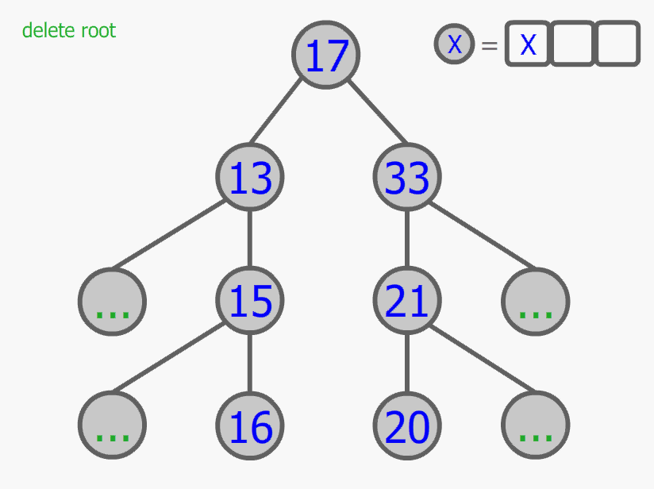
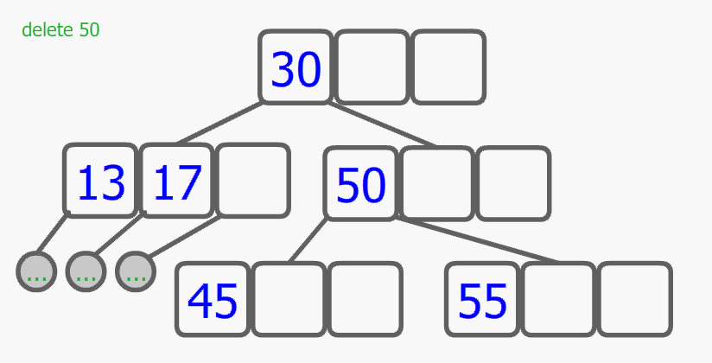
Deletion
Deleting single Leaf
Deleting data from non-single Node
Deleting Root
Deleting data from single Node

Slide 15
Height Analysis
Let height be h
Best Case:
N=no. of Node= 4^h-1≈4^h (All nodes with 4 children)
log₄(4^h)=h
log₄(N)=h
(0.5)log₂(N)=h
Worse Case:
All nodes with exact 2 children, which is similar to balanced binary tree(E.G. AVL/Red-Black Tree)
log₂(N)=h

Slide 16
Time Complexity of Searching
Proportional to the Height of Tree, log₄(N) /log₂(N)
Proportional to the Number of items in each Node
suppose all nodes are full, which contains 3 items
Search time proportional to 3* log₄(N)/3*log₂(N)
Suppose not all nodes are full, which contains 2 items in average
Search time proportional to 2* log₄(N)/2*log₂(N)
Therefore, time complexity for Search = O(logN)
Special Case: Searching the Minimum
Since the Lowest and the most Left Leaf is always the same node
By using a pointer to point the first node from start to end
Searching the Minimum is constant time O(1).

Slide 17
Time Complexity of Delete
Deletion in a 2-3-4 tree is O(log n), assuming transfer and fusion run in constant time ( O(1) ).

Slide 18
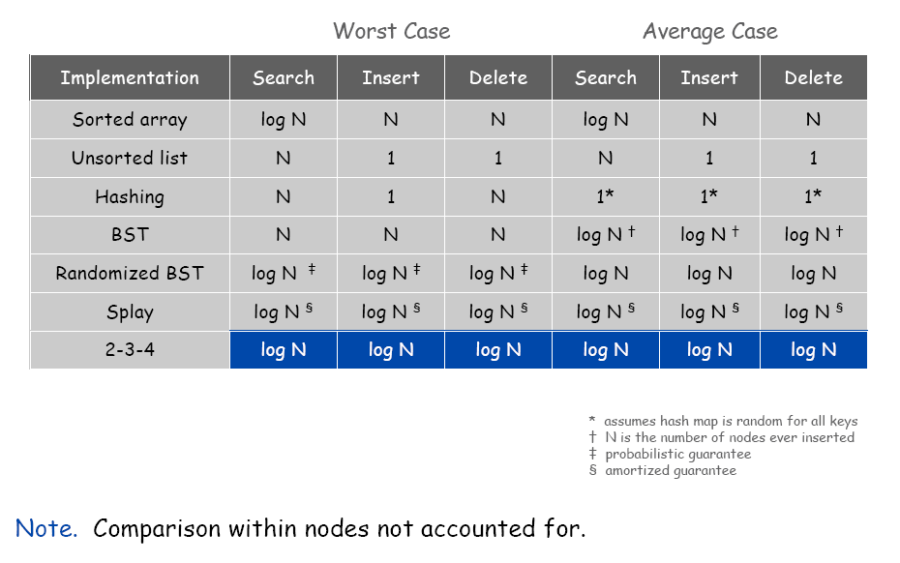
Summary and Comparison of Time Complexity

Slide 19
Deletion
However, many special cases are still needed to handle. E.g. A root with one item and two children and one of the child only has one item .
Therefore, Too many special deletion cases is a big disadvantage of 2-3-4 tree
It also explains why 2-3-4 Tree is commonly used to implement dictionaries since deletion do not occur often/(Never occur).

